Slide 1

Detecting & Eliminating False Sharing
Emery Berger
University of Massachusetts, Amherst
www.cs.umass.edu/~emery

Slide 3
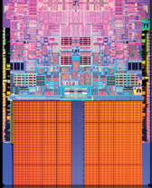

Slide 4
yada yada yada
Notes:
Multicore yada yada

Slide 5

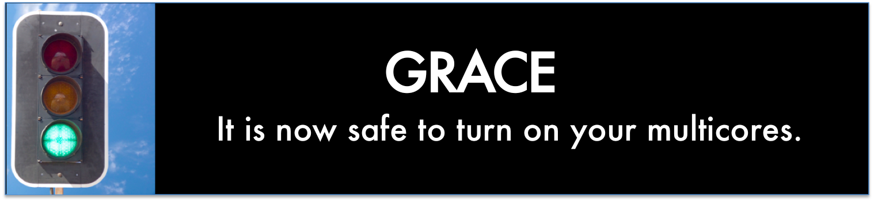
race conditions
atomicity violations
deadlock
order violations

Slide 6
Notes:
Needs to be correct AND fast

Slide 7
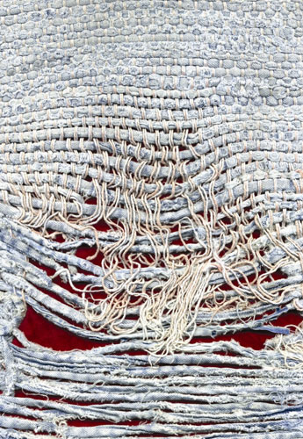
Notes:
Too few threads

Slide 8
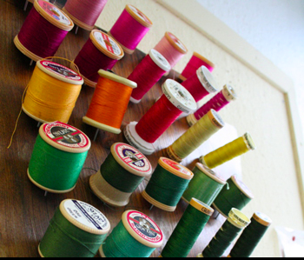
Notes:
Too many threads

Slide 9


( )
Notes:
contention

Slide 10
Notes:
One big lock

Slide 11
Notes:
Fine-grained locks (lock acquisition overhead)

Slide 12

False Sharing!
Notes:
Insidious!

Slide 13
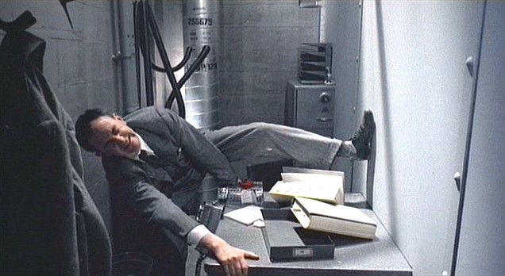
Notes:
(Brazil – didn’t know the desk was shared!)

Slide 14

mine!
yours!
cache line

Slide 15
me = 1;
you = 1; // globals
me = new Foo;
you = new Bar; // heap
class X {
int me;
int you;
}; // fields
arr[me] = 12;
arr[you] = 13; // array indices

Slide 16
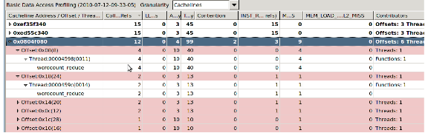

Previous Tools
Instrument every access
200X slowdown, false positives
Performance counters
imprecise, false positives

Slide 18


Slide 19
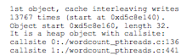

Slide 20
Precise
No false positives

Slide 21
Prevents false sharing

Slide 22

Prevents false sharing

Slide 23


Slide 24

t1 = spawn f(x);
t2 = spawn g(y);
sync;

Slide 25

t1 = spawn f(x);
t2 = spawn g(y);
sync;
if (!fork())
f(x);
if (!fork())
g(y);
Extends Grace: general-purpose programs

Slide 26
X
Y
for (i = 0; i < M; i++)
{
x = 1;
}
for (i = 0; i < M; i++)
{
y = 2;
}

Slide 27
X
Y
0
0
0
0
for (i = 0; i < M; i++)
{
x = 1;
}
for (i = 0; i < M; i++)
{
y = 2;
}

Slide 28
X
Y
0
0
0
0
1
0
for (i = 0; i < M; i++)
{
x = 1;
}
for (i = 0; i < M; i++)
{
y = 2;
}

Slide 29
X
Y
0
0
0
0
1
0
0
2
for (i = 0; i < M; i++)
{
x = 1;
}
for (i = 0; i < M; i++)
{
y = 2;
}

Slide 30
X
Y
0
0
0
0
1
0
0
2

Slide 31
X
Y
0
0
0
0
1
0
0
2
1
0

Slide 32
X
Y
0
0
0
0
1
0
0
2
1
0

Slide 33
X
Y
0
0
0
0
1
0
0
2
1
2

Slide 34
X
Y
0
0
0
0
1
0
0
2
1
2

Slide 35
Identifies heap objects by callsite, globals by name

Slide 36
